Slide 1


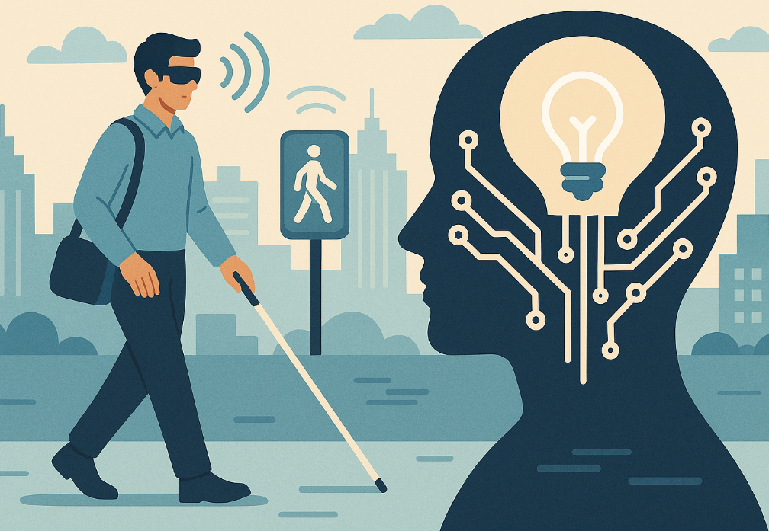

Light for Blind
Bijan Paul
PhD Student, School of Computing
University of Nebraska-Lincoln

Slide 2


Need Lights

Slide 3


The Gap

Slide 4

285M
Need PC Access
One in every 28 people is blind, with 90% in low-income countries.
Costly software-like JAWS
Even Free NVDA often can’t move through all parts of Windows, which keeps blind users stuck
People Worldwide
Source: World Health Organization (WHO)

Slide 5
Track Match

Slide 6
24 Hours
Track: Banana
Creative accessibility tool that helps blind users control the whole PC.
Fun, fresh 24-hour prototype—fits the open, anything-goes spirit.
Built in one day

Slide 7
Accessibility & Inclusion
This ‘Light for Blind’ will remove barriers.
‘Light for Blind’ delivers free, open-source, full Windows navigation
Letting blind students and coders join hackathons and remote work
→
→
Zero Cost
Full Access
Equal Opportunity

Slide 8
A Single 2 MB EXE
Zero Cost
Runs from a USB stick. Easy to installation using MSI or EXE, no admin rights needed.
No licence fees. Democratized tech for everyone, everywhere.

Slide 9
Demo

Slide 10
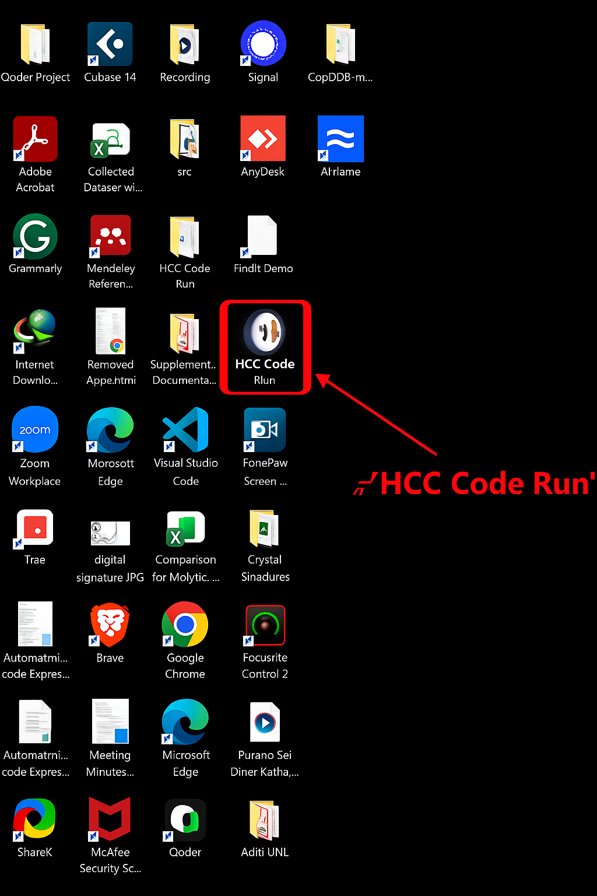
Keystroke Echo in Action
Every key press is spoken aloud instantly
Real-Time Audio based on key stroke

Slide 11
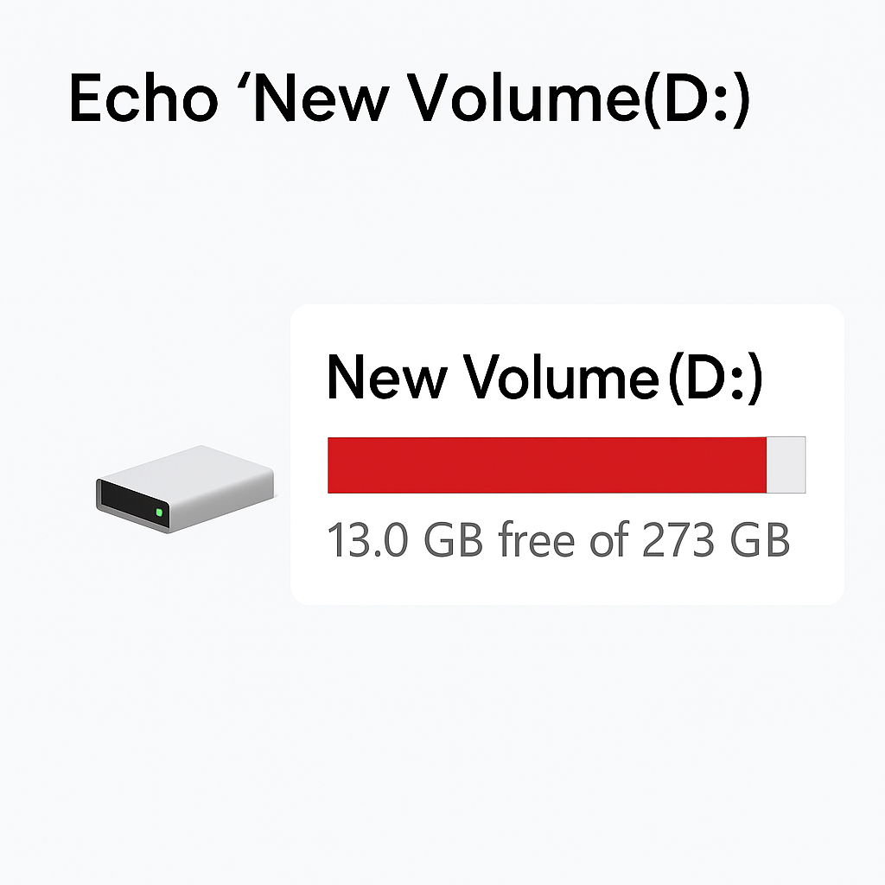
Focus Echo Never Misses
Whether it's a buried Start-menu tile, a nested folder, or a Properties dialog, ‘Light for Blind’ announces the exact name and role of the focused item.
Echo “New Volume (D)"

Slide 12
Impact & Next

Slide 13
From Hack to Global Good
Open Source
Global Requests
Future Vision
MIT Licence on GitHub
Schools in low-income countries
30 Languages & AI
Turning one-day code into lifelong inclusion infrastructure.

Slide 14
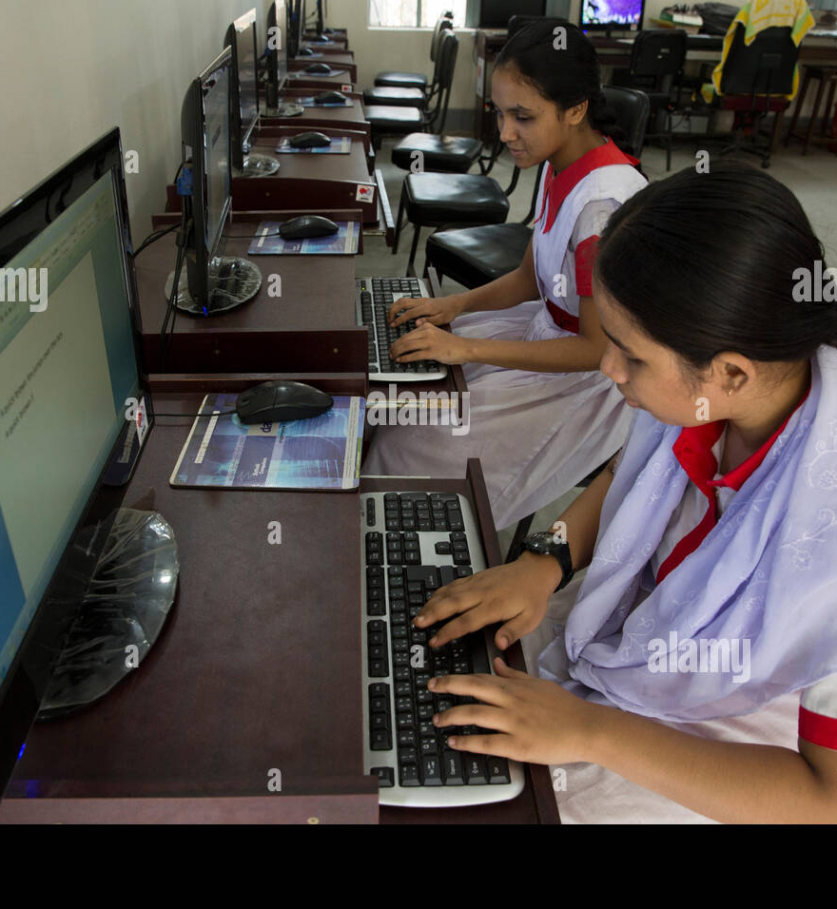
Award Ask
Converting the prototype into sustained social impact, giving 285 million blind users their first-ever full PC freedom at zero cost.

Slide 15
Thank You
‘Light for Blind’ proves that 24 hours, free code, and standard APIs can replace costly software. Together, we move from hack to independence, lighting every PC for the blind worldwide.

